Slide 1
Alaska Department of
Transportation & Public Facilities
Construction Aspects of the
Greenroads® Rating System
Robert J DeVassie, P.E., STP, DOT&PF Project Engineer
October 31, 2016

Slide 2

What is Greenroads?
Greenroads® is a rating system that measures and manages sustainability on transportation projects. The rating system challenges project teams to go above and beyond minimum environmental, social and economic practices with an independent, third-party review.
Notes:
It is applicable to all types and sizes of roadway projects, including new, rehabilitation, reconstruction, preservation and bridge projects.
Sustainable (Merriam-Webster): able to be used without being completely used up or destroyed; involving methods that do not completely use up or destroy natural resources; able to last or continue for a long time.

Slide 3
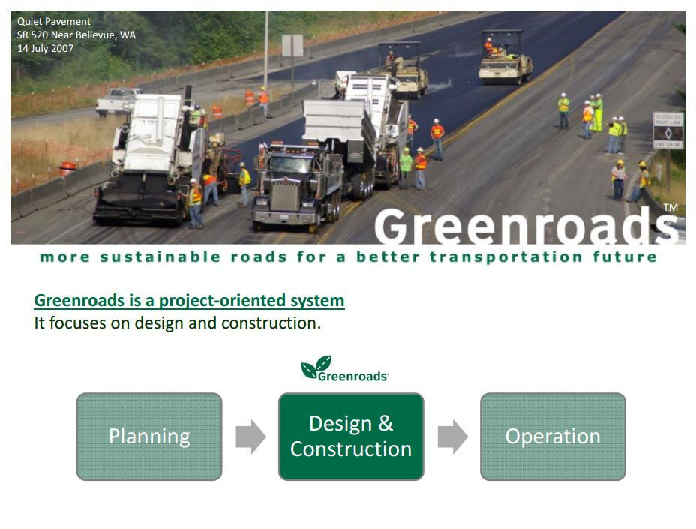
Improving Roadway Sustainability
Notes:
It is applicable to all types and sizes of roadway projects, including new, rehabilitation, reconstruction, preservation and bridge projects.
Greenroads provides quantifiable sustainability benefits backed by rigorous empirical evidence.
Projects can be certified through an easy-to-use online interface.
Greenroads® and its logo are registered trademarks of the Greenroads Foundation.

Slide 4
Who Can Use Greenroads?
The Greenroads Manual is available for free and can be used by anyone.
Greenroads can be helpful to roadway owners, transportation planners, designers, contractors, developers, policy makers, materials suppliers and students, etc.
Website: www.greenroads.org
Notes:
Watch video on website.

Slide 5
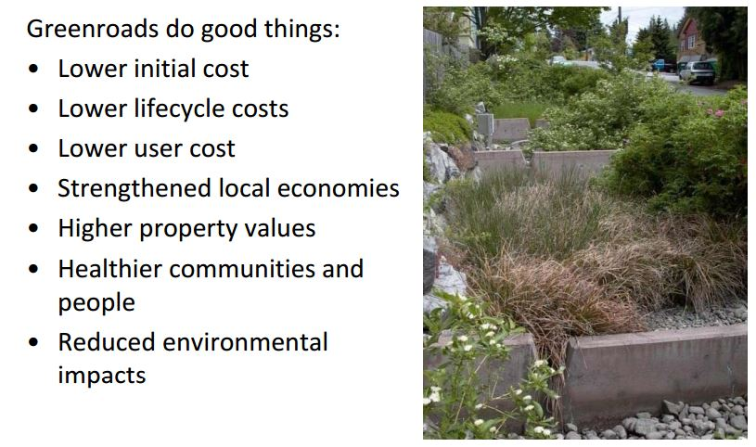
Benefits of Greenroads

Slide 6
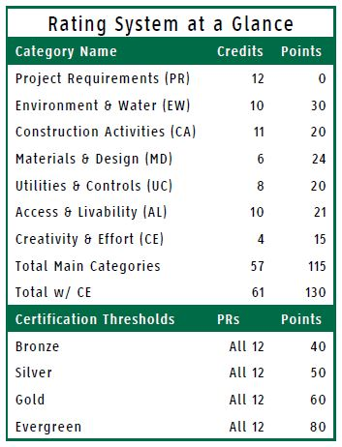
What Topics are Covered by Greenroads?
Categories:
Project Requirements
Voluntary Credits
  Environmental & Water
  Construction Activities
  Materials & Design
  Utilities & Controls
  Access & Livability
Creativity & Effort

Slide 7
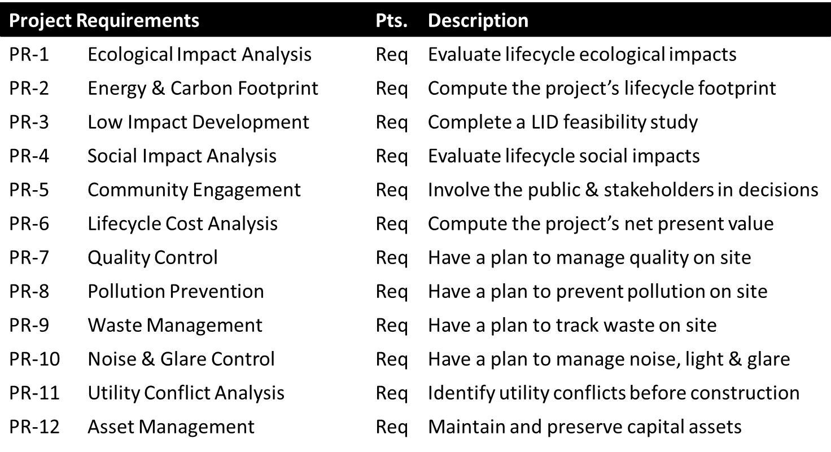
Project Requirements

Slide 8
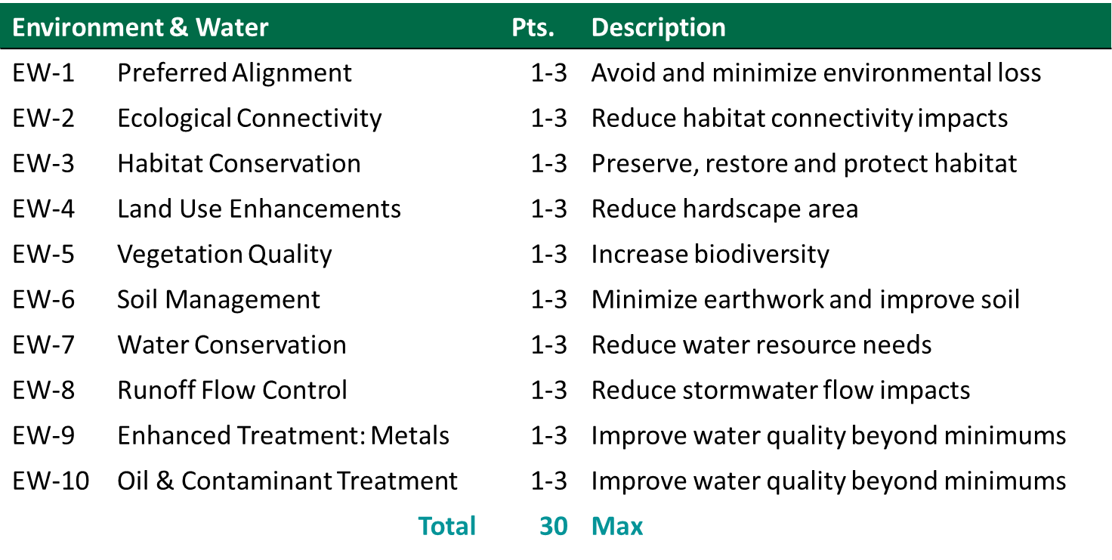
Voluntary Credits

Slide 9
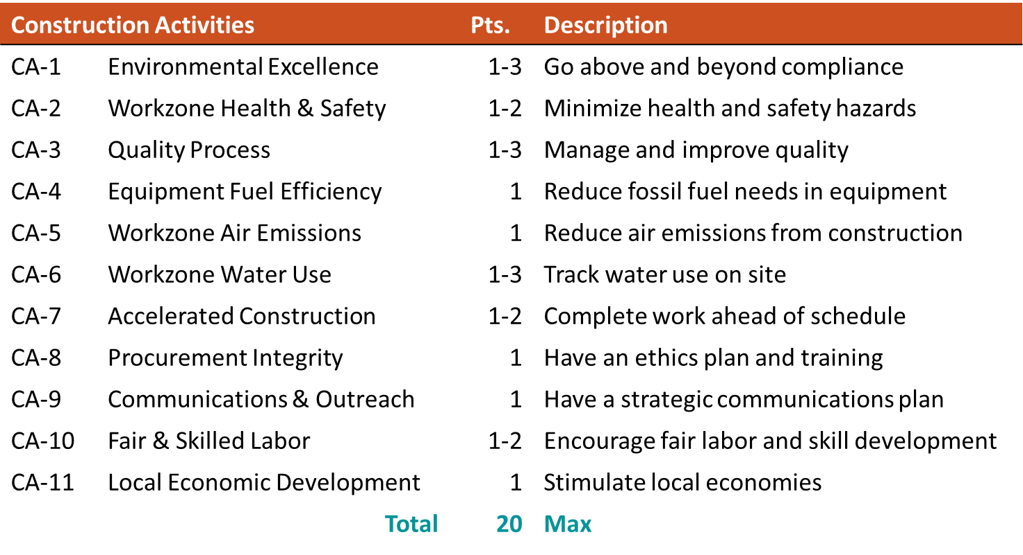
Voluntary Credits

Slide 10
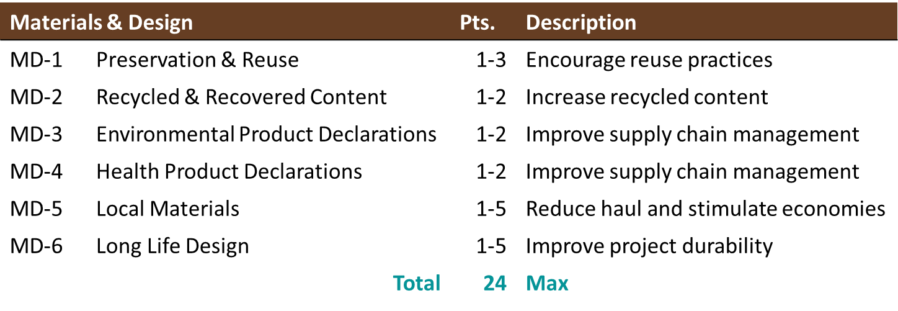
Voluntary Credits

Slide 11
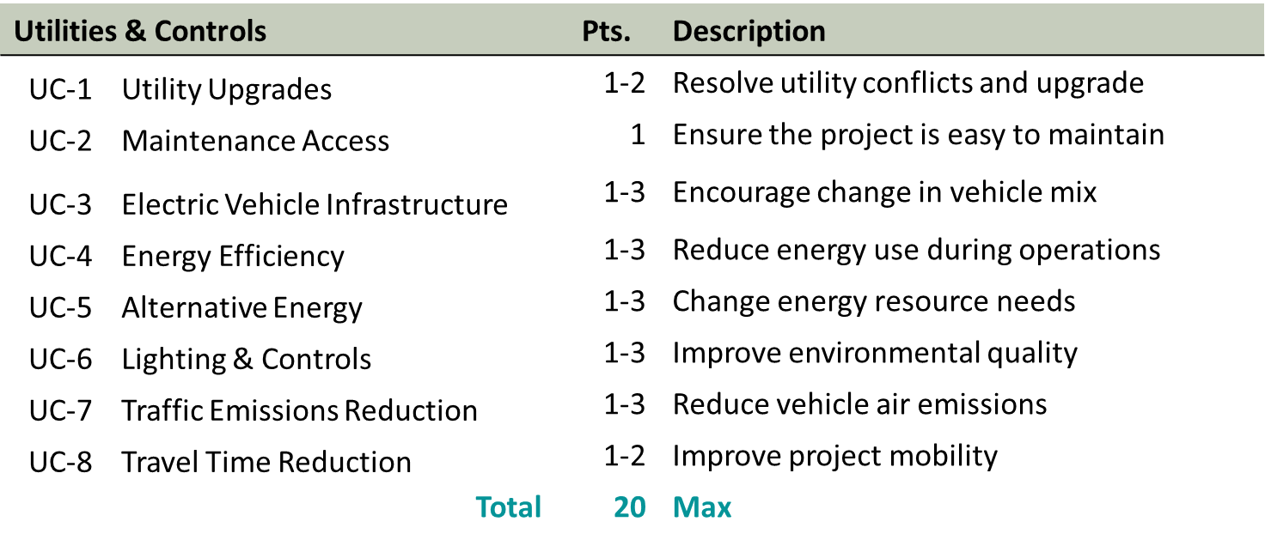
Voluntary Credits

Slide 12
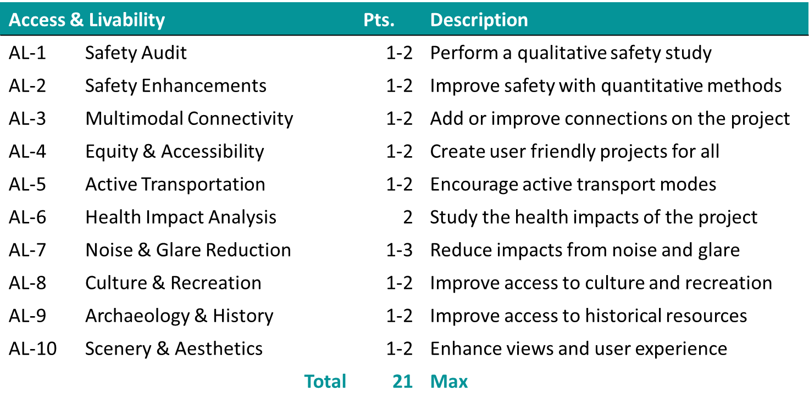
Voluntary Credits

Slide 13
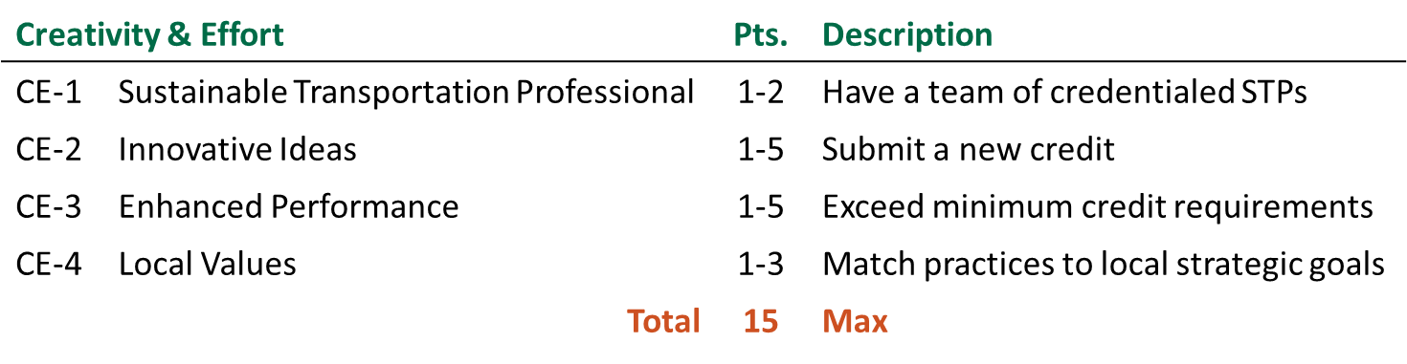
Creativity & Effort

Slide 14
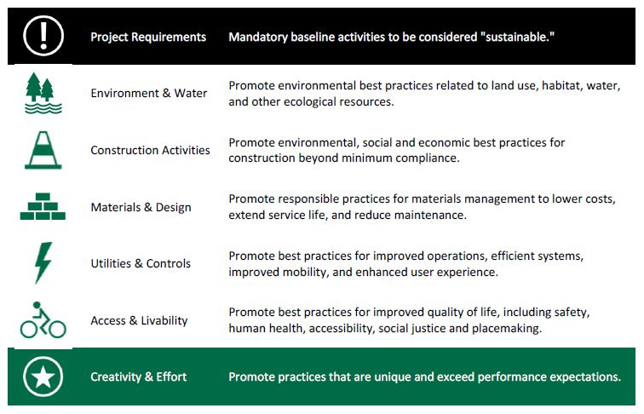

Credit Categories & Intent

Slide 15
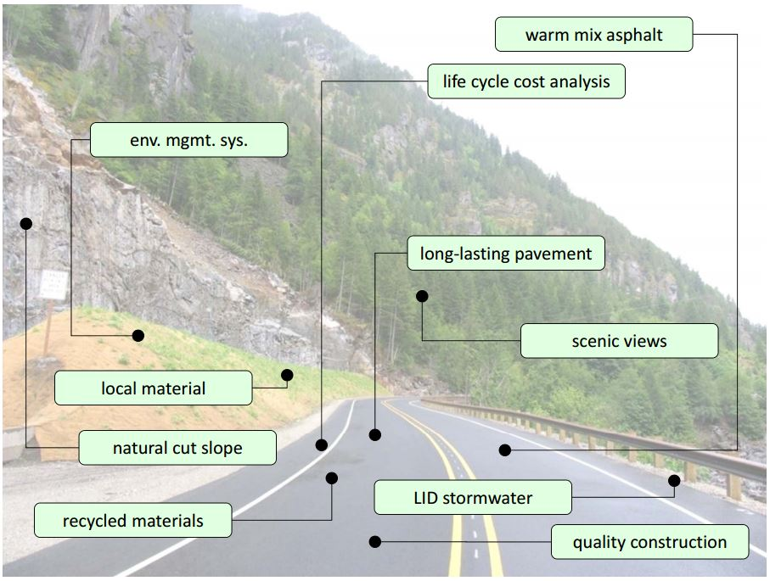
What Does a Rural Greenroad Look Like?

Slide 16
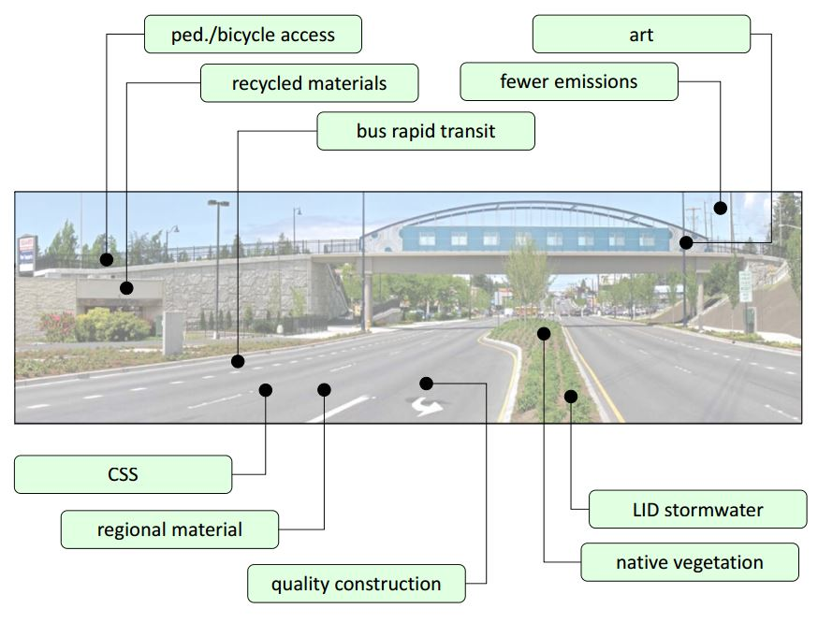
What Does an Urban Greenroad Look Like?

Slide 17
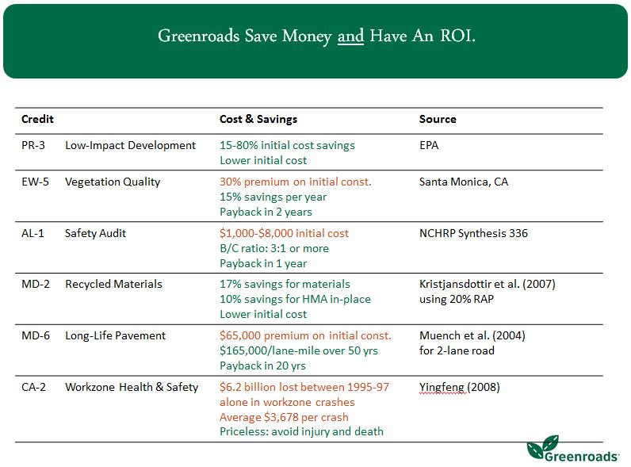
Why Rate Your Project?

Slide 18
How Much Does it Cost?
Screening is FREE.
Registration & Project Support varies:
  Prospective - $900 per year: 1-5 yrs. before NTP
  Committed - $1800 per year: 1-3 yrs. before NTP
  Active - $2700 per year: 1-2 yrs. before NTP
Certification is based on the size of the Project. (design + EE of construction + ROW)
  Ex. $16.1 million = est. cost of $7,550

Slide 19
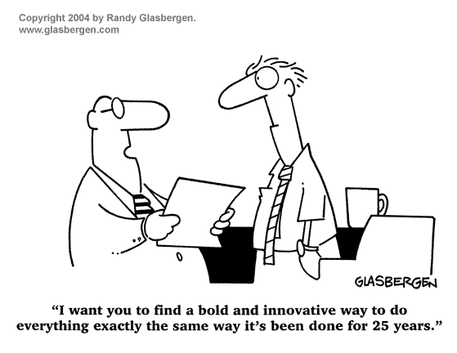
Registration and Project Support
Welcome Webinar
Directory Listing
Target Score
Kickoff Training
Online Access:
  Greenroads Rating System and Help
  Greenroads Project Workspace

Slide 20
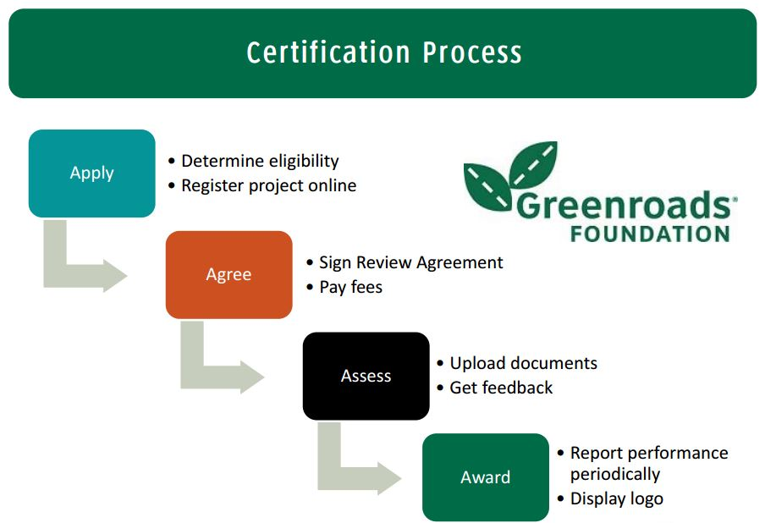
How Do I Get Rated?

Slide 21
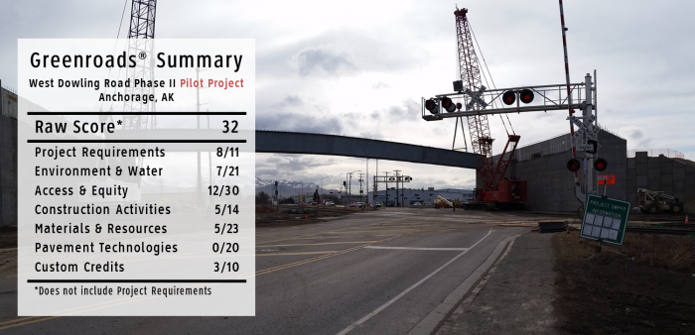
Alaska’s 1st Greenroads Pilot Project

Slide 22
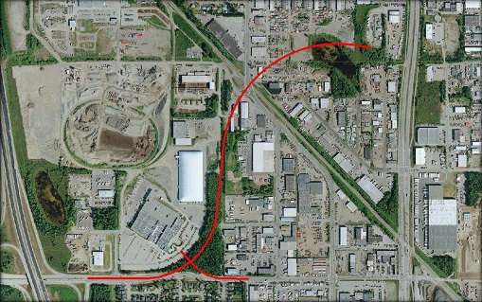
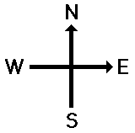
West Dowling Rd - Description
Extend Dowling Road west from C Street to Minnesota Drive.
two lanes in both directions,
new bridge
new signalized intersections
lighting
bike lanes
shared use pathways
street improvements
wetlands
new drainage facilities
sewer utilities
bioswales
Notes:
The project will extend Dowling Road to the west from C Street to Minnesota Drive. The alignment consists of the construction of two lanes in both directions, including a new bridge over the Alaska Railroad tracks at Arctic Boulevard, new signalized intersections and lighting throughout the corridor, Class A bike lanes, and a shared use path on both sides. Additional street improvements on Raspberry Road, Arctic Boulevard, Electron Drive, Alaska’s Best Place, and Howard Holton Court will also be completed. Environmental concerns are paramount due to the corridor passing through a wetland area at Tina Lake. New drainage facilities and sewer utilities will also be constructed, including bioswales and improvements to drainage for flooding at Tina Lake. The surrounding area is mostly developed industrial properties and some residential buildings.

Slide 23
What Did We Learn?
“Not only did we want to open up this entire corridor for easy, multimodal access; we wanted to do it the smartest way possible.”
  Quoted by Jim Amundsen, P.E., Highway Design Group Chief and former Project Manager
  Alaska Dispatch News, Nov. 10, 2015

Slide 24




West Dowling Rd – Pilot Project
Construction Cost: $46.8 million
Owner: Alaska DOT&PF
Design: HDR Alaska
Contractor: Granite Construction
Bronze Certification is possible.

Slide 25


